Slide 1
Digital learning environment

Slide 2
SHARE

Slide 3
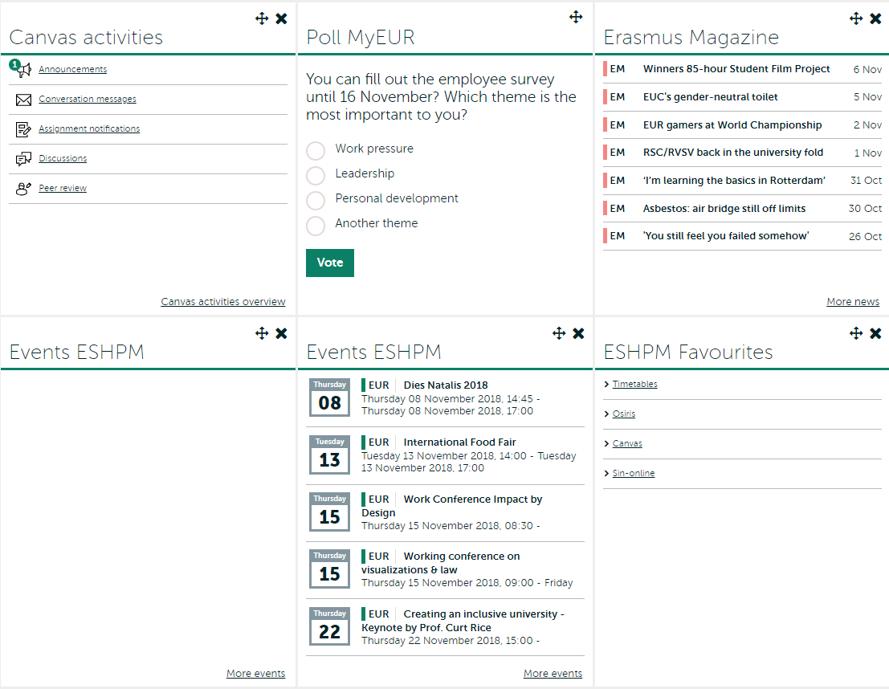
www.my.eur.nl

Slide 4
Where to go?
Osiris
Register for subjects, exams and resits
De-register for subjects
Grades
Sin-online
Register for workgroups
Informationchannels
Osiris app
Webpage ESHPM
Examination Regulations

Slide 9
Osiris app
App for iPhone en Android
Timetable
Grades
Messages
News
Feedback

Slide 10
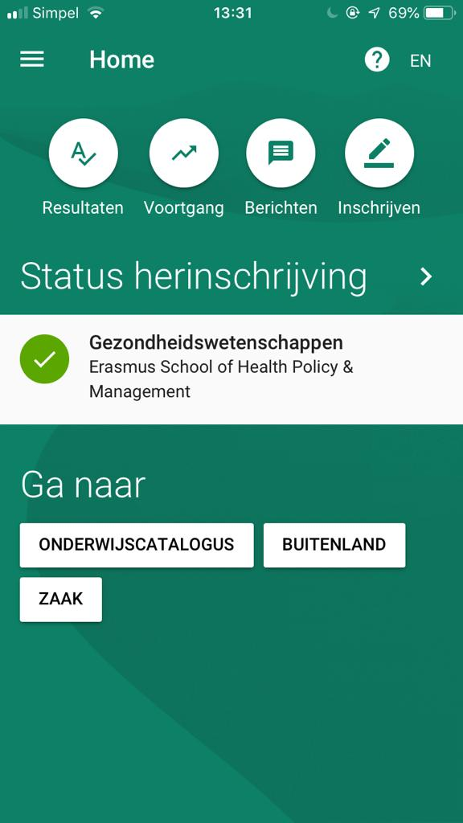
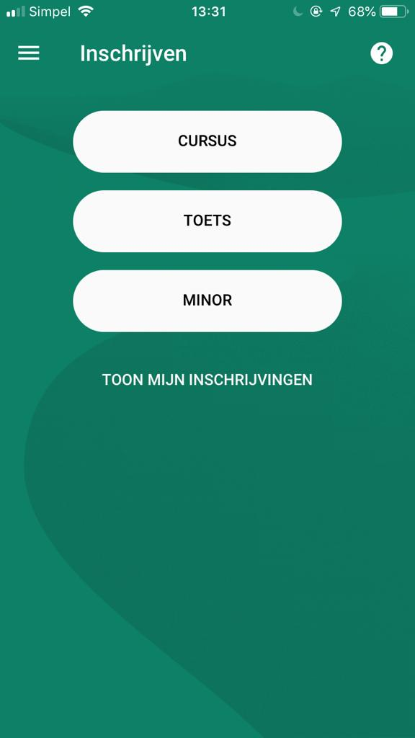
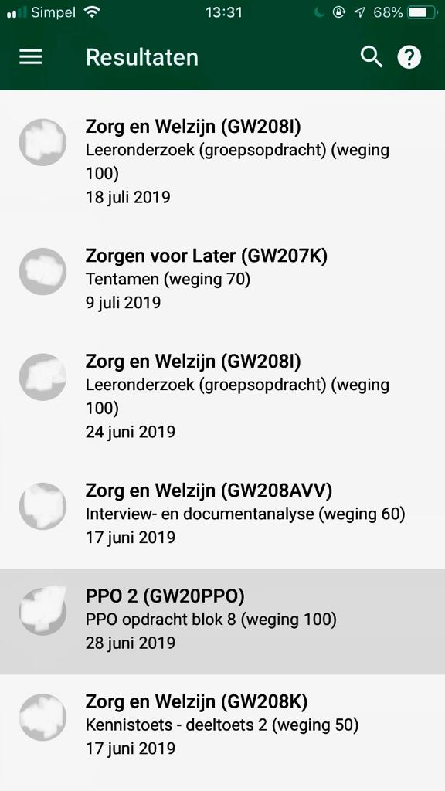
Osiris app

Slide 11
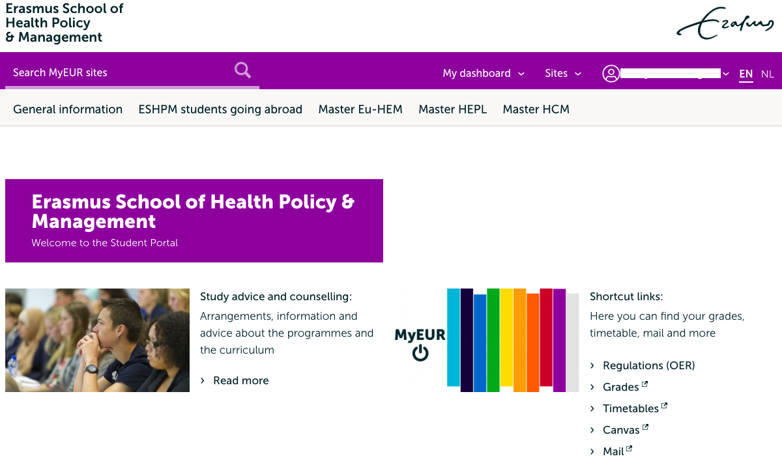
Website ESHPM
Teaching and Examination Regulations
Examinationboard
Study advice
my.eur.nl/eshpm

Slide 12
Access to scientific data outside the campus
UB-website: log in with your ERNA-account
Google Scholar: change the settings in Google Scholar*
Install Library Access browser (single registration)*
*For more information: https://www.eur.nl/en/campus/university-library/using-library/campus-access

Slide 13
Questions?
 | Practical questions | Technical questions | Powerpoint/SHARE
Who | Onderwijs Service Centrum | ICT desk | Faculty Association SHARE
Location | J7-09 | H02-01 & T04-09 | J7-35
Email address | osc@eshpm.eur.nl | servicedesk@ict.eur.nl | Board@share-fa.com
Phone number | +31 10-408 8575 | +31 1040 88880 | +31 10-408 88570

